Slide 1
Spack: Package management for HPC
ATPESC 2023 St Charles, Illinois
August 4, 2023
Notes:
1

Slide 2

Modern scientific codes rely on icebergs of dependency libraries
71 packages
188 dependencies
MFEM: Higher-order finite elements
31 packages,
69 dependencies
LBANN: Neural Nets for HPC
r-condop: R Genome Data Analysis Tools
179 packages,
527 dependencies

Slide 3
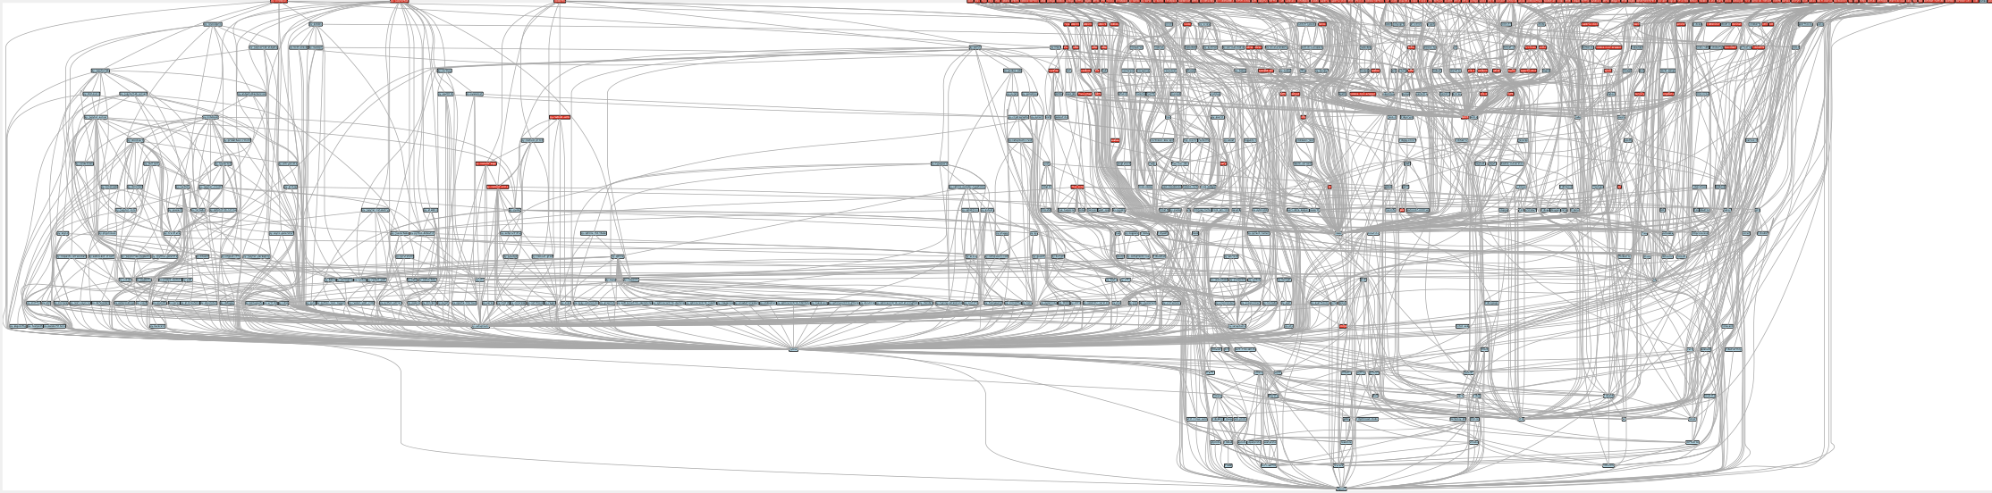
ECP’s E4S stack is even larger than these codes
Red boxes are the packages in it (about 100)
Blue boxes are what else you need to build it (about 600)
It’s infeasible to build and integrate all of this manually

Slide 4
Some fairly common (but questionable) assumptions made by package managers (conda, pip, apt, etc.)
1:1 relationship between source code and binary (per platform)
Good for reproducibility (e.g., Debian)
Bad for performance optimization
Binaries should be as portable as possible
What most distributions do
Again, bad for performance
Toolchain is the same across the ecosystem
One compiler, one set of runtime libraries
Or, no compiler (for interpreted languages)
Outside these boundaries, users are typically on their own

Slide 5
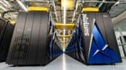
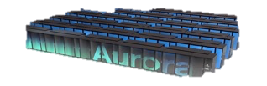
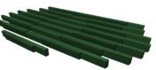


High Performance Computing (HPC) violates many of these assumptions
Some Supercomputers
Code is typically distributed as source
With exception of vendor libraries, compilers
Often build many variants of the same package
Developers’ builds may be very different
Many first-time builds when machines are new
Code is optimized for the processor and GPU
Must make effective use of the hardware
Can make 10-100x perf difference
Rely heavily on system packages
Need to use optimized libraries that come with machines
Need to use host GPU libraries and network
Multi-language
C, C++, Fortran, Python, others all in the same ecosystem
Summit
Fugaku
Oak Ridge National Lab
Power9 / NVIDIA
RIKEN
Fujitsu/ARM a64fx
NERSC-9
Aurora
Perlmutter
Lawrence Berkeley National Lab
AMD Zen / NVIDIA
Argonne National Lab
Intel Xeon / Xe
Lawrence Livermore National Lab AMD Zen / Radeon
Oak Ridge National Lab
AMD Zen / Radeon

Slide 6





What about containers?
Containers provide a great way to reproduce and distribute an already-built software stack
Someone needs to build the container!
This isn’t trivial
Containerized applications still have hundreds of dependencies
Using the OS package manager inside a container is insufficient
Most binaries are built unoptimized
Generic binaries, not optimized for specific architectures
HPC containers may need to be rebuilt to support many different hosts, anyway.
Not clear that we can ever build one container for all facilities
Containers likely won’t solve the N-platforms problem in HPC
We need something more flexible to build the containers

Slide 7
Spack enables Software distribution for HPC
Spack automates the build and installation of scientific software
Packages are parameterized, so that users can easily tweak and tune configuration
Ease of use of mainstream tools, with flexibility needed for HPC
In addition to CLI, Spack also:
Generates (but does not require) modules
Allows conda/virtualenv-like environments
Provides many devops features (CI, container generation, more)
No installation required: clone and go
$ git clone https://github.com/spack/spack
$ spack install hdf5
Simple syntax enables complex installs
$ spack install hdf5@1.10.5
$ spack install hdf5@1.10.5 %clang@6.0
$ spack install hdf5@1.10.5 +threadssafe
$ spack install hdf5@1.10.5 cppflags="-O3 –g3"
$ spack install hdf5@1.10.5 target=haswell
$ spack install hdf5@1.10.5 +mpi ^mpich@3.2
github.com/spack/spack

Slide 8
What’s a package manager?
Spack is a package manager
Does not a replace Cmake/Autotools
Packages built by Spack can have any build system they want
Spack manages dependencies
Drives package-level build systems
Ensures consistent builds
Determining magic configure lines takes time
Spack is a cache of recipes
Package Manager
Manages package installation
May drive package-level build systems
High Level Build System
Cmake, Autotools
Handle library abstractions
Low Level Build System
Make, Ninja
Handles dependencies among commands in a single build
Generate Makefiles, etc.
Manages dependency relationships

Slide 9
Who can use Spack?
People who want to use or distribute software for HPC!
End Users of HPC Software
Install and run HPC applications and tools
HPC Application Teams
Manage third-party dependency libraries
Package Developers
People who want to package their own software for distribution
User support teams at HPC Centers
People who deploy software for users at large HPC sites

Slide 10
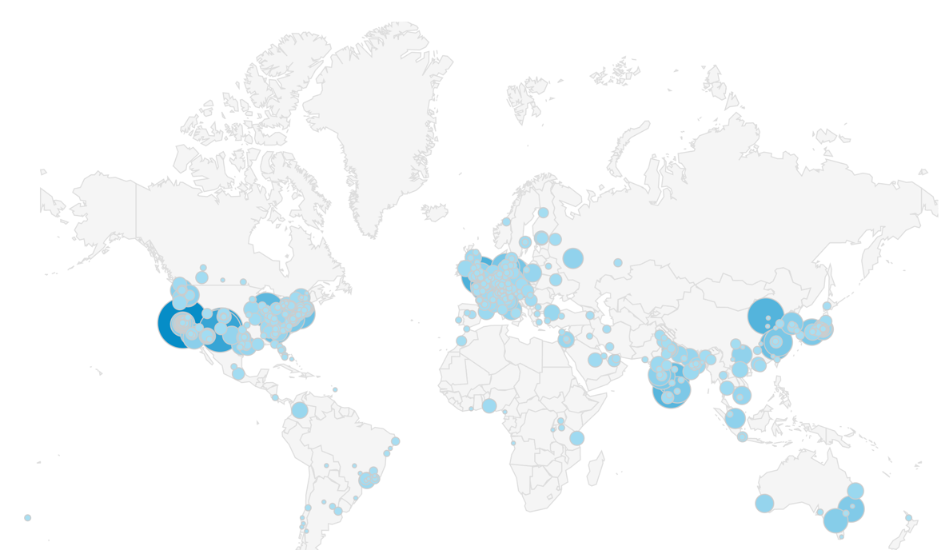
Spack sustains the HPC software ecosystem with the help of many contributors
Over 6,900 software packages
Over 1,100 contributors
Most package contributions are not from DOE But they help sustain the DOE ecosystem!

Slide 11
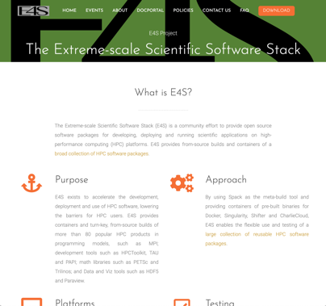

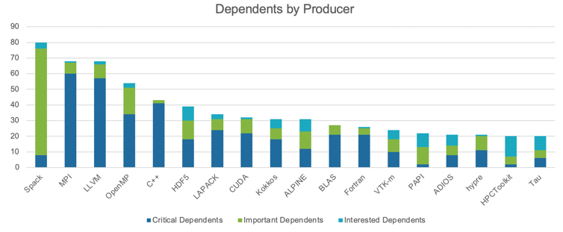
Spack is critical for ECP’s mission to create a robust, capable exascale software ecosystem.
https://e4s.io
Spack will be used to build software for the three upcoming U.S. exascale systems
ECP has built the Extreme Scale Scientific Software Stack (E4S) with Spack – more at https://e4s.io
Spack will be integral to upcoming ECP testing efforts.
Spack is the most depended-upon project in ECP

Slide 12
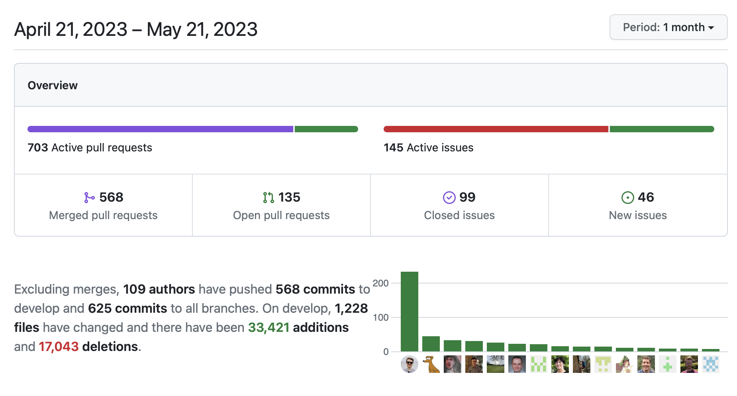
One month of Spack development is pretty busy!

Slide 13








Spack’s widespread adoption has drawn contributions and collaborations with many vendors
AWS invests significantly in cloud credits for Spack build farm
Joint Spack tutorial with AWS had 125+ participants
Joint AWS/AHUG Spack Hackathon drew 60+ participants
AMD has contributed ROCm packages and compiler support
55+ PRs mostly from AMD, also others
ROCm, HIP, aocc packages are all in Spack now
HPE/Cray is doing internal CI for Spack packages, in the Cray environment
Intel contributing OneApi support and licenses for our build farm
NVIDIA contributing NVHPC compiler support and other features
Fujitsu and RIKEN have contributed a huge number of packages for ARM/a64fx support on Fugaku
ARM and Linaro members contributing ARM support
400+ pull requests for ARM support from various companies

Slide 14
Spack v0.20.0 was released at ISC23!
Major new features:
requires() directive, enhanced package requirements
Exact versions with @=
New testing interface
More stable concretization
Weekly develop snapshot releases
Specs in buildcaches can be referenced by hash
New package and buildcache index websites
Default CMake and Meson build types are now Release
github.com/spack/spack
Full release notes: https://github.com/spack/spack/releases/tag/v0.20.0

Slide 15







Spack is not the only tool that automates builds
“Functional” Package Managers
Nix https://nixos.org/
Guix https://www.gnu.org/s/guix/
Build-from-source Package Managers
Homebrew, LinuxBrew http://brew.sh
MacPorts https://www.macports.org
Gentoo https://gentoo.org
Other tools in the HPC Space:
Easybuild http://hpcugent.github.io/easybuild/
An installation tool for HPC
Focused on HPC system administrators – different package model from Spack
Relies on a fixed software stack – harder to tweak recipes for experimentation
Conda / Mamba https://conda.io
Very popular binary package ecosystem for data science
Not targeted at HPC; generally has unoptimized binaries

Slide 16
Most existing tools do not support combinatorial versioning
Traditional binary package managers
RPM, yum, APT, yast, etc.
Designed to manage a single stack.
Install one version of each package in a single prefix (/usr).
Seamless upgrades to a stable, well tested stack
Port systems
BSD Ports, portage, Macports, Homebrew, Gentoo, etc.
Minimal support for builds parameterized by compilers, dependency versions.
Virtual Machines and Linux Containers (Docker)
Containers allow users to build environments for different applications.
Does not solve the build problem (someone has to build the image)
Performance, security, and upgrade issues prevent widespread HPC deployment.

Slide 17
Spack provides a spec syntax to describe customized package configurations
$ spack install mpileaks unconstrained
$ spack install mpileaks@3.3 @ custom version
$ spack install mpileaks@3.3 %gcc@4.7.3 % custom compiler
$ spack install mpileaks@3.3 %gcc@4.7.3 +threads +/- build option
$ spack install mpileaks@3.3 cppflags="-O3 –g3" set compiler flags
$ spack install mpileaks@3.3 target=cascadelake set target microarchitecture
$ spack install mpileaks@3.3 ^mpich@3.2 %gcc@4.9.3 ^ dependency constraints
Each expression is a spec for a particular configuration
Each clause adds a constraint to the spec
Constraints are optional – specify only what you need.
Customize install on the command line!
Spec syntax is recursive
Full control over the combinatorial build space

Slide 18
Spack packages are parameterized using the spec syntax Python DSL defines many ways to build
from spack import *
class Kripke(CMakePackage):
"""Kripke is a simple, scalable, 3D Sn deterministic particle transport mini-app."""
homepage = "https://computation.llnl.gov/projects/co-design/kripke"
url = "https://computation.llnl.gov/projects/co-design/download/kripke-openmp-1.1.tar.gz"
version(‘1.2.3’, sha256='3f7f2eef0d1ba5825780d626741eb0b3f026a096048d7ec4794d2a7dfbe2b8a6’)
version(‘1.2.2’, sha256='eaf9ddf562416974157b34d00c3a1c880fc5296fce2aa2efa039a86e0976f3a3’)
version('1.1’, sha256='232d74072fc7b848fa2adc8a1bc839ae8fb5f96d50224186601f55554a25f64a’)
variant('mpi', default=True, description='Build with MPI.’)
variant('openmp', default=True, description='Build with OpenMP enabled.’)
depends_on('mpi', when='+mpi’)
depends_on('cmake@3.0:', type='build’)
def cmake_args(self):
return [
'-DENABLE_OPENMP=%s’ % ('+openmp’ in self.spec),
'-DENABLE_MPI=%s' % ('+mpi’ in self.spec),
]
def install(self, spec, prefix):
mkdirp(prefix.bin)
install('../spack-build/kripke', prefix.bin)
Base package
(CMake support)
Metadata at the class level
Versions
Variants (build options)
Dependencies (same spec syntax)
Install logic in instance methods
Don’t typically need install() for CMakePackage, but we can work around codes that don’t have it.
One package.py file per software project!

Slide 19
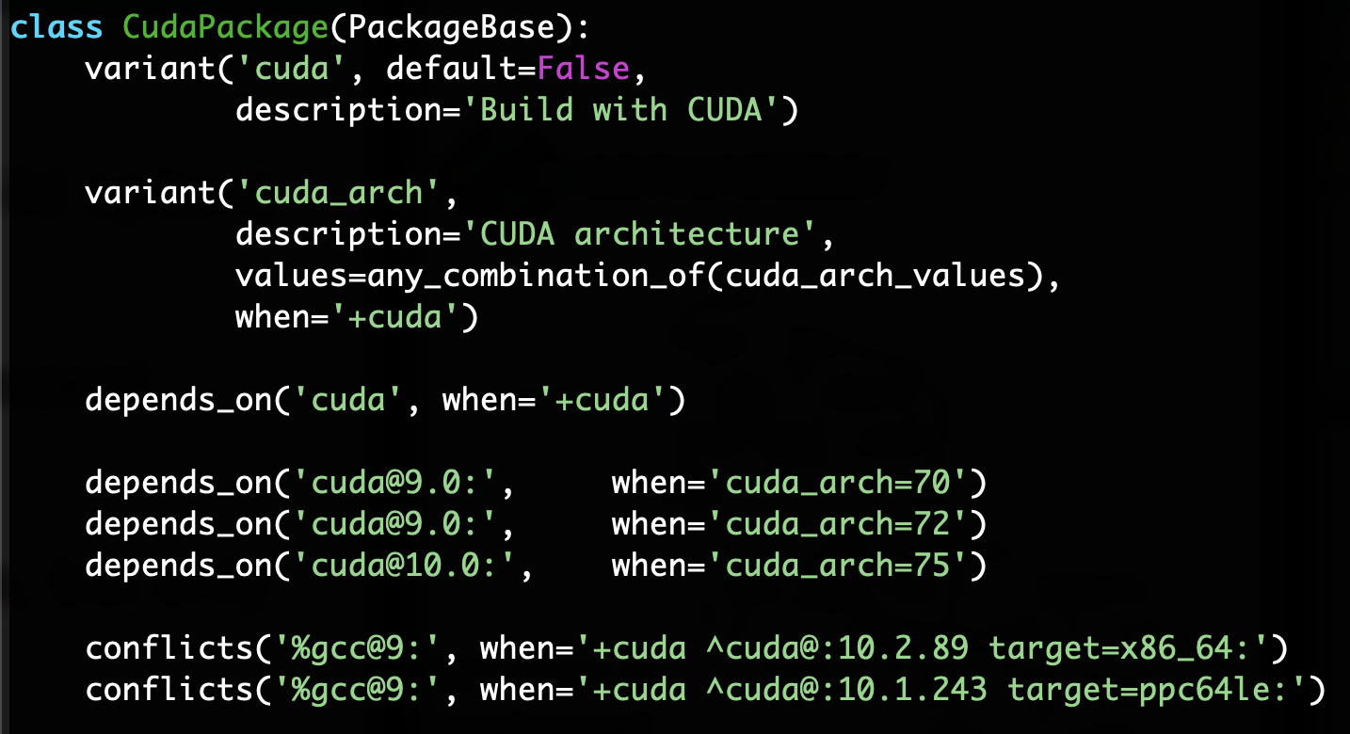
Conditional variants simplify packages
CudaPackage: a mix-in for packages that use CUDA
cuda is a variant (build option)
cuda_arch is only present if cuda is enabled
dependency on cuda, but only if cuda is enabled
constraints on cuda version
compiler support for x86_64 and ppc64le
There is a lot of expressive power in the Spack package DSL.

Slide 20
Spack Specs can constrain versions of dependencies
$ spack install mpileaks %intel@12.1 ^libelf@0.8.12
Spack ensures one configuration of each library per DAG
Ensures ABI consistency.
User does not need to know DAG structure; only the dependency names.
Spack can ensure that builds use the same compiler, or you can mix
Working on ensuring ABI compatibility when compilers are mixed.

Slide 21
Spack handles ABI-incompatible, versioned interfaces like MPI
mpi is a virtual dependency
Install the same package built with two different MPI implementations:
Let Spack choose MPI implementation, as long as it provides MPI 2 interface:
$ spack install mpileaks ^mvapich@1.9
$ spack install mpileaks ^openmpi@1.4:
$ spack install mpileaks ^mpi@2

Slide 22
Concretization fills in missing configuration details when the user is not explicit.
mpileaks ^callpath@1.0+debug ^libelf@0.8.11
User input: abstract spec with some constraints
spec.yaml
spec:
- mpileaks:
arch: linux-x86_64
compiler:
name: gcc
version: 4.9.2
dependencies:
adept-utils: kszrtkpbzac3ss2ixcjkcorlaybnptp4
callpath: bah5f4h4d2n47mgycej2mtrnrivvxy77
mpich: aa4ar6ifj23yijqmdabeakpejcli72t3
hash: 33hjjhxi7p6gyzn5ptgyes7sghyprujh
variants: {}
version: '1.0'
- adept-utils:
arch: linux-x86_64
compiler:
name: gcc
version: 4.9.2
dependencies:
boost: teesjv7ehpe5ksspjim5dk43a7qnowlq
mpich: aa4ar6ifj23yijqmdabeakpejcli72t3
hash: kszrtkpbzac3ss2ixcjkcorlaybnptp4
variants: {}
version: 1.0.1
- boost:
arch: linux-x86_64
compiler:
name: gcc
version: 4.9.2
dependencies: {}
hash: teesjv7ehpe5ksspjim5dk43a7qnowlq
variants: {}
version: 1.59.0
...
Normalize
Concretize
Store
Abstract, normalized spec
with some dependencies.
Concrete spec is fully constrained
and can be passed to install.
Detailed provenance is stored
with the installed package

Slide 23
Hashing allows us to handle combinatorial complexity
Dependency DAG
Each unique dependency graph is a unique configuration.
Each configuration in a unique directory.
Multiple configurations of the same package can coexist.
Hash of entire directed acyclic graph (DAG) is appended to each prefix.
Installed packages automatically find dependencies
Spack embeds RPATHs in binaries.
No need to use modules or set LD_LIBRARY_PATH
Things work the way you built them
Installation Layout
Hash
opt
└── spack
├── darwin-mojave-skylake
│ └── clang-10.0.0-apple
│ ├── bzip2-1.0.8-hc4sm4vuzpm4znmvrfzri4ow2mkphe2e
│ ├── python-3.7.6-daqqpssxb6qbfrztsezkmhus3xoflbsy
│ ├── sqlite-3.30.1-u64v26igxvxyn23hysmklfums6tgjv5r
│ ├── xz-5.2.4-u5eawkvaoc7vonabe6nndkcfwuv233cj
│ └── zlib-1.2.11-x46q4wm46ay4pltriijbgizxjrhbaka6
├── darwin-mojave-x86_64
│ └── clang-10.0.0-apple
│ └── coreutils-8.29-pl2kcytejqcys5dzecfrtjqxfdssvnob
opt
└── spack
├── darwin-mojave-skylake
│ └── clang-10.0.0-apple
│ ├── bzip2-1.0.8-hc4sm4vuzpm4znmvrfzri4ow2mkphe2e
│ ├── python-3.7.6-daqqpssxb6qbfrztsezkmhus3xoflbsy
│ ├── sqlite-3.30.1-u64v26igxvxyn23hysmklfums6tgjv5r
│ ├── xz-5.2.4-u5eawkvaoc7vonabe6nndkcfwuv233cj
│ └── zlib-1.2.11-x46q4wm46ay4pltriijbgizxjrhbaka6
├── darwin-mojave-x86_64
│ └── clang-10.0.0-apple
│ └── coreutils-8.29-pl2kcytejqcys5dzecfrtjqxfdssvnob

Slide 24
An isolated compilation environment allows Spack to easily swap compilers
Spack Process
Forked build process isolates environment for each build. Uses compiler wrappers to:
Add include, lib, and RPATH flags
Ensure that dependencies are found automatically
Load Cray modules (use right compiler/system deps)
do_install()
Install dep1
Install dep2
…
Install package
icc
icpc
ifort
Fork
Build Process
Set up environment
CC = spack/env/spack-cc SPACK_CC = /opt/ic-15.1/bin/icc
CXX = spack/env/spack-c++ SPACK_CXX = /opt/ic-15.1/bin/icpc
F77 = spack/env/spack-f77 SPACK_F77 = /opt/ic-15.1/bin/ifort
FC = spack/env/spack-f90 SPACK_FC = /opt/ic-15.1/bin/ifort
PKG_CONFIG_PATH = ... PATH = spack/env:$PATH
CMAKE_PREFIX_PATH = ...
LIBRARY_PATH = ...
Compiler wrappers (spack-cc, spack-c++, spack-f77, spack-f90)
-I /dep1-prefix/include
-L /dep1-prefix/lib
-Wl,-rpath=/dep1-prefix/lib
install()
configure
make
make install

Slide 25

We can configure Spack to build with external software
mpileaks ^callpath@1.0+debug
^openmpi ^libelf@0.8.11
packages.yaml
packages:
mpi:
buildable: False
paths:
openmpi@2.0.0 %gcc@4.7.3 arch=linux-rhel6-ppc64:
/path/to/external/gcc/openmpi-2.0.0
openmpi@1.10.3 %gcc@4.7.3 arch=linux-rhel6-ppc64:
/path/to/external/gcc/openmpi-1.10.3
...
/path/to/external/gcc/openmpi-2.0.0
Users register external packages in a configuration file (more on these later).
Spack prunes the DAG when adding external packages.

Slide 26
Spack package repositories allow stacks to be layered
LLNL MARBL multi-physics application
llnl.wci.mapp
marbl
blast
miranda
MARBL Application Packages
Common internal packages
llnl.wci
$ spack repo create /path/to/my_repo
$ spack repo add my_repo
$ spack repo list
==> 2 package repositories.
my_repo /path/to/my_repo
builtin spack/var/spack/repos/builtin
leos
builtin
Open Source Spack packages
boost
raja
axom

Slide 27


Spack mirrors
Original source
on internet
Spack allows you to define mirrors:
Directories in the filesystem
On a web server
In an S3 bucket
Mirrors are archives of fetched tarballs, repositories, and other resources needed to build
Can also contain binary packages
By default, Spack maintains a mirror in var/spack/cache of everything you’ve fetched so far.
You can host mirrors internal to your site
See the documentation for more details
S3 Bucket
Shared FS
Local cache
Spack users

Slide 28
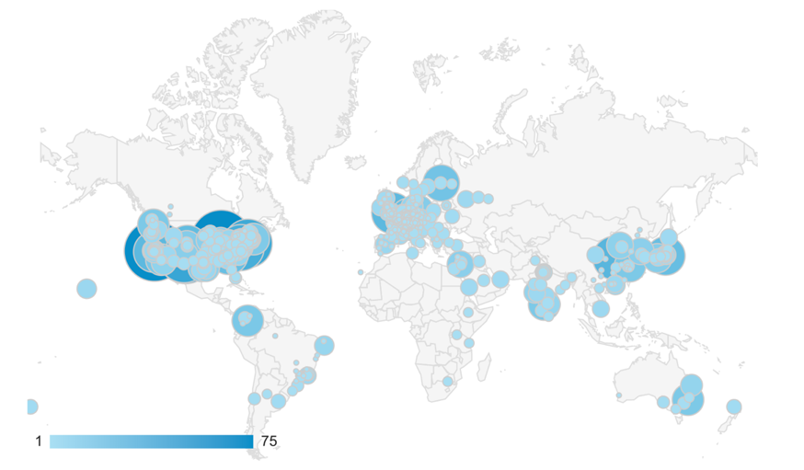
The concretizer includes information from packages, configuration, and CLI
Dependency solving is NP-hard
Contributors
package.py repository
new versions
new dependencies
new constraints
concretizer
spack developers
default config
packages.yaml
yaml
admins, users
local preferences config packages.yaml
yaml
users
local environment config spack.yaml
yaml
Concrete spec is fully constrained
and can be built.
Command line constraints
users
spack install hdf5@1.12.0 +debug

Slide 29
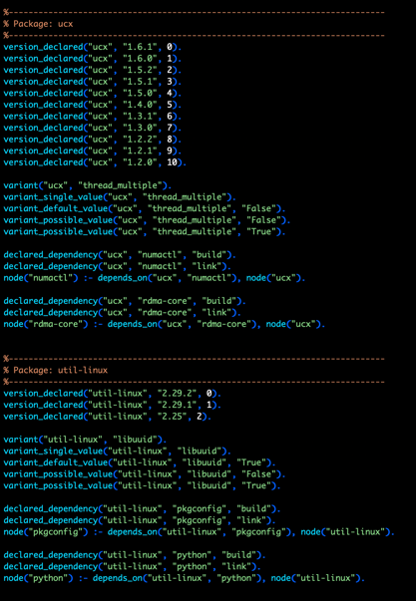
We use logic programming to simplify package solving
New concretizer leverages Clingo (see potassco.org)
Clingo is an Answer Set Programming (ASP) solver
ASP looks like Prolog; leverages SAT solvers for speed/correctness
ASP program has 2 parts:
Large list of facts generated from our package repositories and config
Small logic program (~800 lines)
includes constraints and optimization criteria
New algorithm on the Spack side is conceptually simpler:
Generate facts for all possible dependencies, send to logic program
Optimization criteria express preferences more clearly
Build a DAG from the results
New concretizer solves many specs that old concretizer can’t
Backtracking is a huge win – many issues resolved
Conditional logic that was complicated before is now much easier
Some facts for the HDF5 package

Slide 30
--fresh only reuses builds if hashes match
Hash matches are very sensitive to small changes
In many cases, a satisfying cached or already installed spec can be missed
Nix, Spack, Guix, Conan, and others reuse this way
1. Resolve metadata
2. Create per-node hashes
cwx4qwk4bkamf4gjrglmxfu3bhasyt74
qo2af23r2npatxdtna3fmwkeennywixp
k2yumgxwq6ijubivfpbjpmrrbzyqcoot
Package cache
4xxvh5ldm7gm32ngtixcm2odaer3cvvb
74mwnxgn6nujehpyyalhwizwojwn5zga
??
6zvh4ueem6f5yrcfugh67k2hrtxbgbcs
3. Query for exact hash match

Slide 31
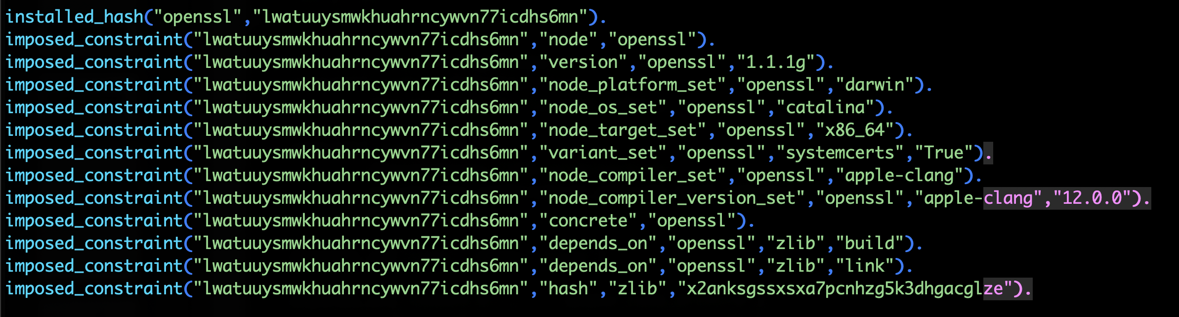
--reuse (now the default) is more aggressive
--reuse tells the solver about all the installed packages!
Add constraints for all installed packages, with their hash as the associated ID:

Slide 32
Telling the solver to minimize builds is surprisingly simple in ASP
1. Allow the solver to choose a hash for any package:
2. Choosing a hash means we impose its constraints:
3. Define a build as something without a hash:
4. Minimize builds!

Slide 33
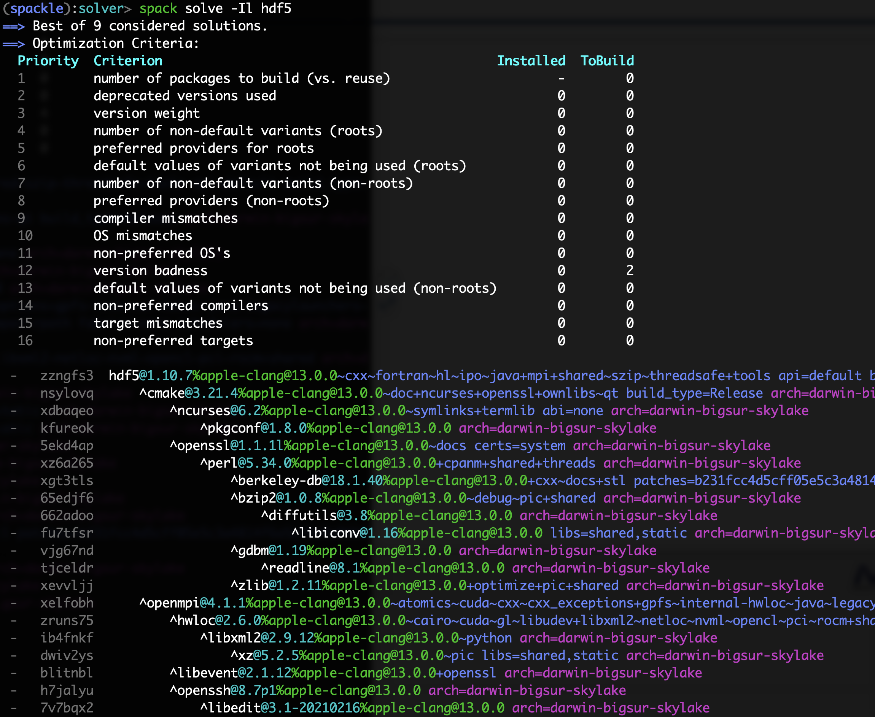
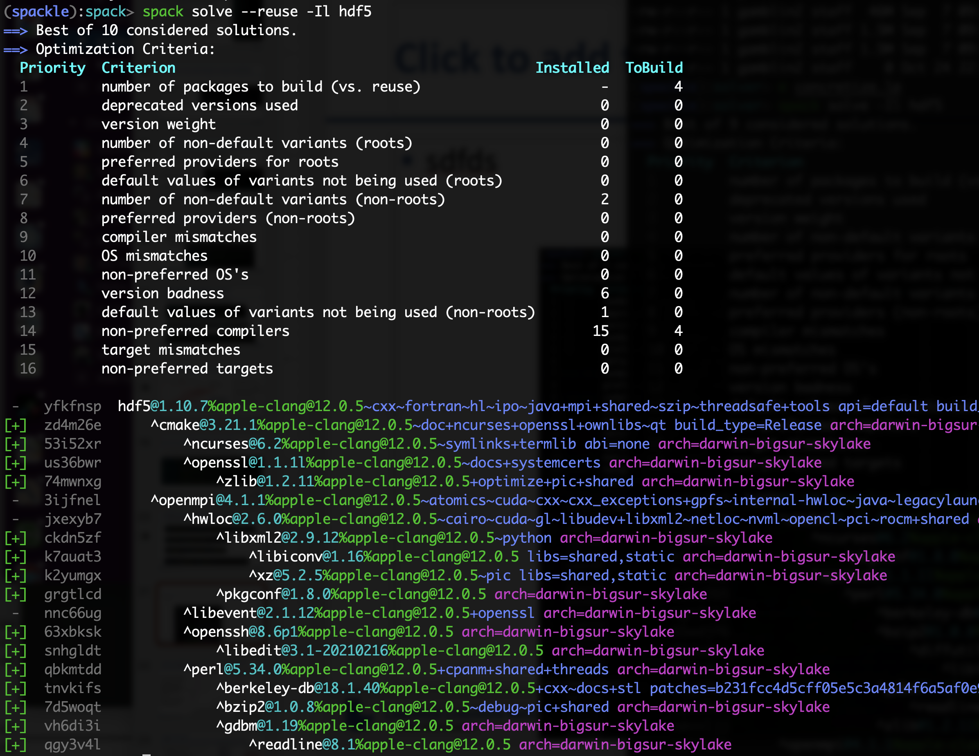

With and without --reuse optimization
Pure hash-based reuse: all misses
With reuse: 16 packages were reusable

Slide 34
Use `spack spec` to see the results of concretization
$ spack spec mpileaks
Input spec
------------------------------
mpileaks
Concretized
------------------------------
mpileaks@1.0%gcc@5.3.0 arch=darwin-elcapitan-x86_64
^adept-utils@1.0.1%gcc@5.3.0 arch=darwin-elcapitan-x86_64
^boost@1.61.0%gcc@5.3.0+atomic+chrono+date_time~debug+filesystem~graph
~icu_support+iostreams+locale+log+math~mpi+multithreaded+program_options
~python+random +regex+serialization+shared+signals+singlethreaded+system
+test+thread+timer+wave arch=darwin-elcapitan-x86_64
^bzip2@1.0.6%gcc@5.3.0 arch=darwin-elcapitan-x86_64
^zlib@1.2.8%gcc@5.3.0 arch=darwin-elcapitan-x86_64
^openmpi@2.0.0%gcc@5.3.0~mxm~pmi~psm~psm2~slurm~sqlite3~thread_multiple~tm~verbs+vt arch=darwin-elcapitan-x86_64
^hwloc@1.11.3%gcc@5.3.0 arch=darwin-elcapitan-x86_64
^libpciaccess@0.13.4%gcc@5.3.0 arch=darwin-elcapitan-x86_64
^libtool@2.4.6%gcc@5.3.0 arch=darwin-elcapitan-x86_64
^m4@1.4.17%gcc@5.3.0+sigsegv arch=darwin-elcapitan-x86_64
^libsigsegv@2.10%gcc@5.3.0 arch=darwin-elcapitan-x86_64
^callpath@1.0.2%gcc@5.3.0 arch=darwin-elcapitan-x86_64
^dyninst@9.2.0%gcc@5.3.0~stat_dysect arch=darwin-elcapitan-x86_64
^libdwarf@20160507%gcc@5.3.0 arch=darwin-elcapitan-x86_64
^libelf@0.8.13%gcc@5.3.0 arch=darwin-elcapitan-x86_64

Slide 35
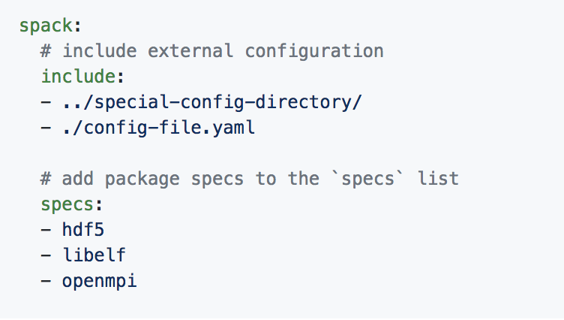
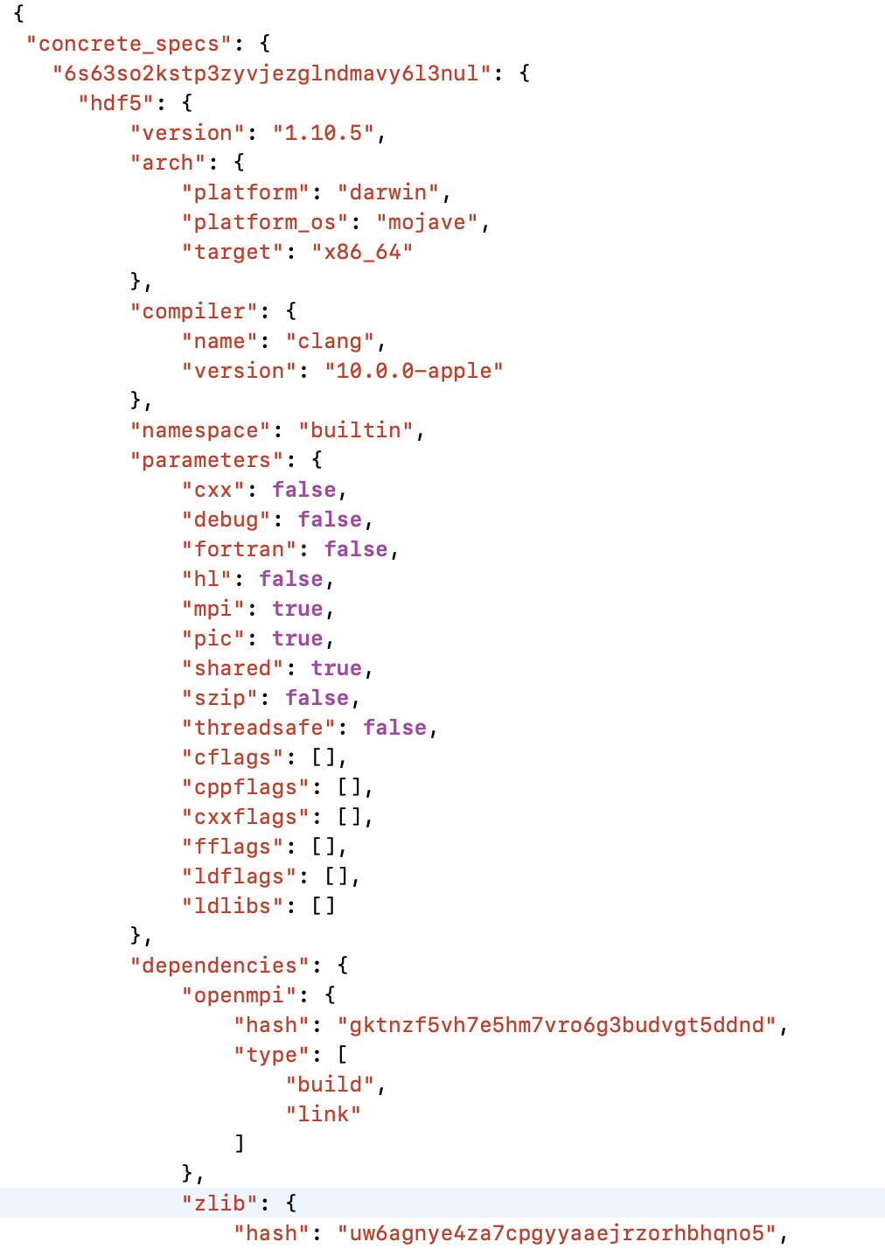
Spack environments enable users to build customized stacks from an abstract description
Simple spack.yaml file
Concretize
Install
spack.yaml file describes requirements
spack.lock describes exact versions installed
Pacakge installations
spack.yaml describes project requirements
spack.lock describes exactly what versions/configurations were installed, allows them to be reproduced.
Can be used to maintain configuration of a software stack.
Can easily version an environment in a repository
Concrete spack.lock file (generated)

Slide 36
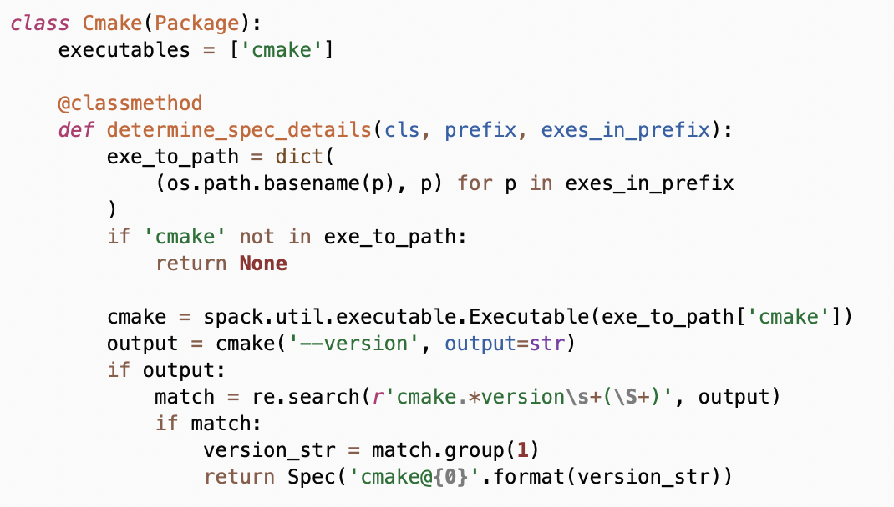
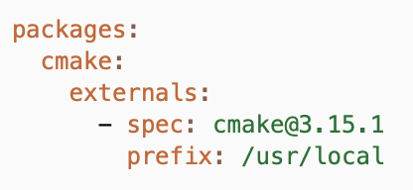
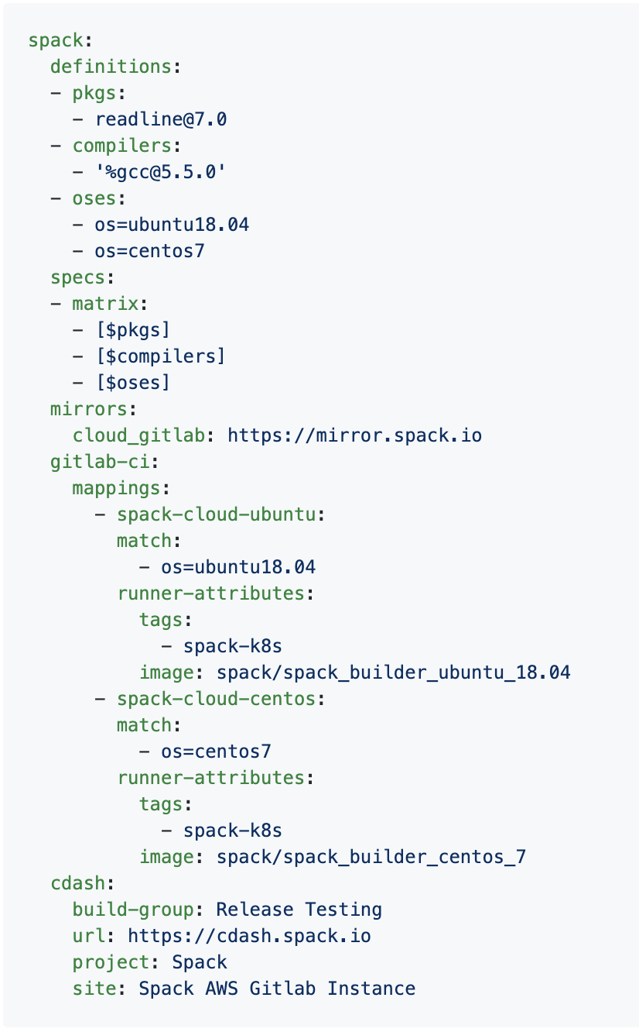

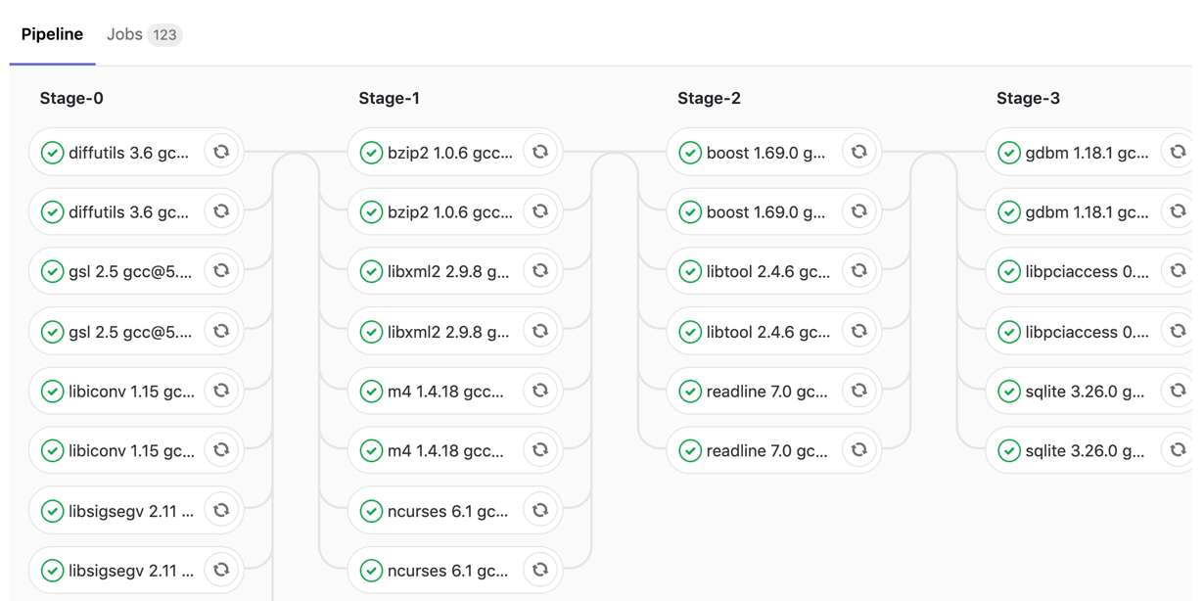
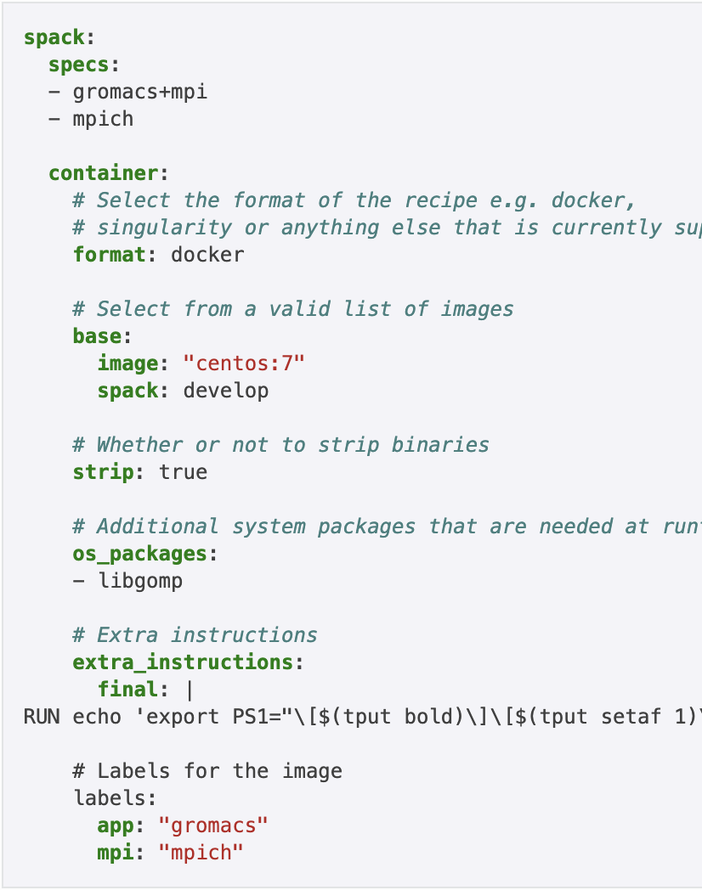
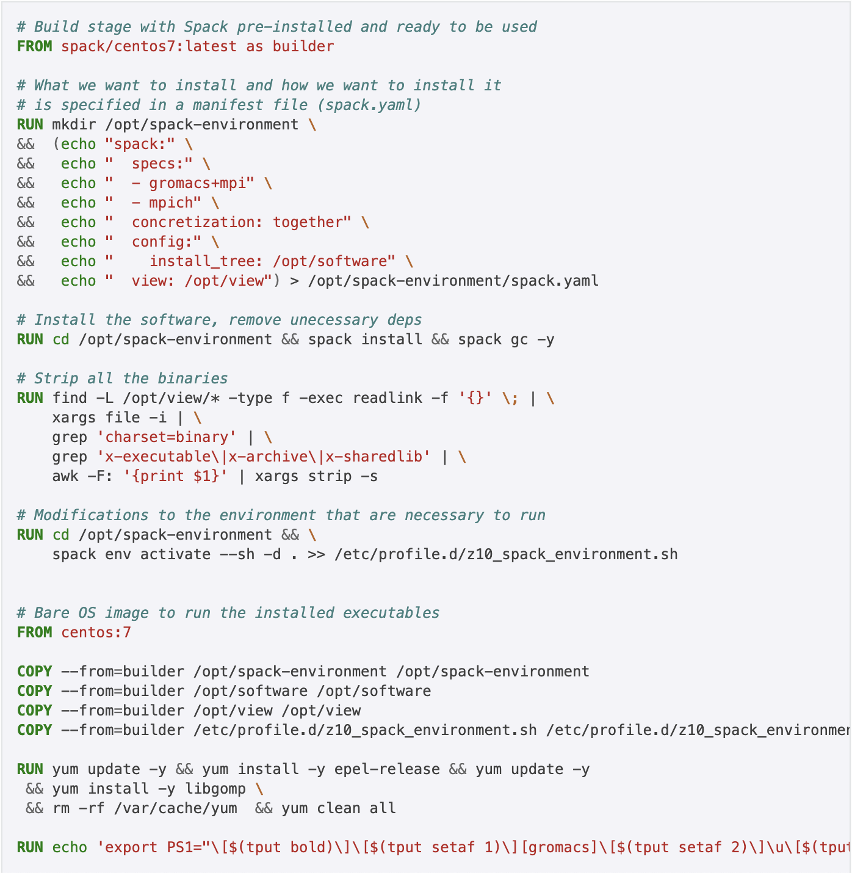

Environments have enabled us to add build many features to support developer workflows
spack external find
Automatically find and configure external packages on the system
class Libsigsegv(AutotoolsPackage, GNUMirrorPackage):
"""GNU libsigsegv is a library for handling page faults in user mode."""
# ... spack package contents ...
extra_install_tests = ‘tests/.libs’
def test(self):
data_dir = self.test_suite.current_test_data_dir
smoke_test_c = data_dir.join(‘smoke_test.c’)
self.run_test(
'cc’, [
'-I%s' % self.prefix.include,
'-L%s' % self.prefix.lib, '-lsigsegv’,
smoke_test_c,
'-o', 'smoke_test'
]
purpose='check linking’)
self.run_test(
‘smoke_test’, [], data_dir.join('smoke_test.out’),
purpose=‘run built smoke test’)
self.run_test('sigsegv1': ['Test passed’], purpose='check sigsegv1 output’)
self.run_test('sigsegv2': ['Test passed’], purpose='check sigsegv2 output’)
spack test
package.py
spack.yaml configuration
Packages know how to run their own test suites
package.py
spack ci
Automatically generate parallel build pipelines
(more on this later)
.gitlab-ci.yml CI pipeline
spack containerize
spack.yaml
Turn environments into container build recipes

Slide 37
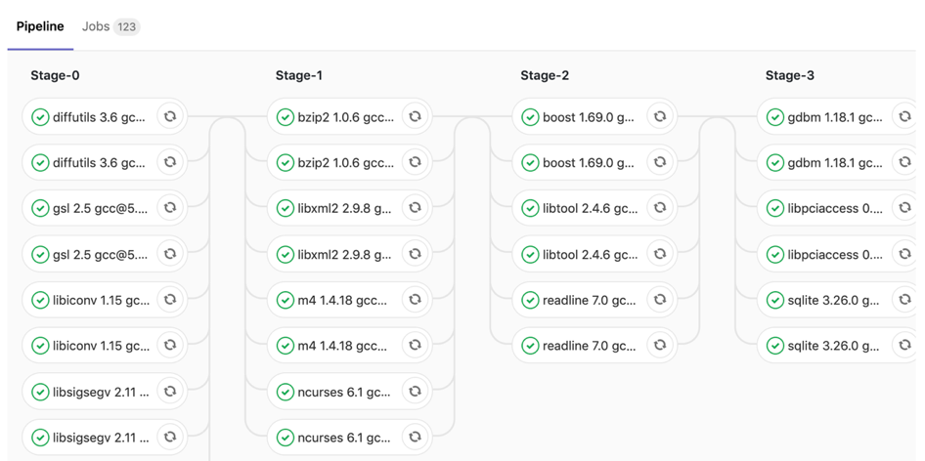
Spack environments are the foundation of Spack CI
spack ci enables any environment to be turned into a build pipeline
Pipeline generates a .gitlab-ci.yml file from spack.lock
Pipelines can be used just to build, or to generate relocatable binary packages
Binary packages can be used to keep the same build from running twice
Same repository used for spack.yaml can generate pipelines for project
Parallel GitLab build pipeline
spack.yaml

Slide 38
The Spack project enables communities to build their own software stacks
Lots of Software Stacks!
E4S
AWS
LLNL stack
xSDK
Vis SDK
App
. . .
Spack Community 💁‍♂️ 💁🏾 💁 💁🏻‍♀️ 💁🏻 💁🏾‍♂️ 💁🏻‍♂️ 💁‍♀️ 💁🏼‍♂️ 💁🏾‍♀️ 💁🏼 💁🏽‍♀️ 💁🏽‍♂️ 💁🏽 💁🏼‍♀️ 💁🏼‍♂️
CI Infrastructure
Package Recipes
Core tool (CLI + Solver)

Slide 39
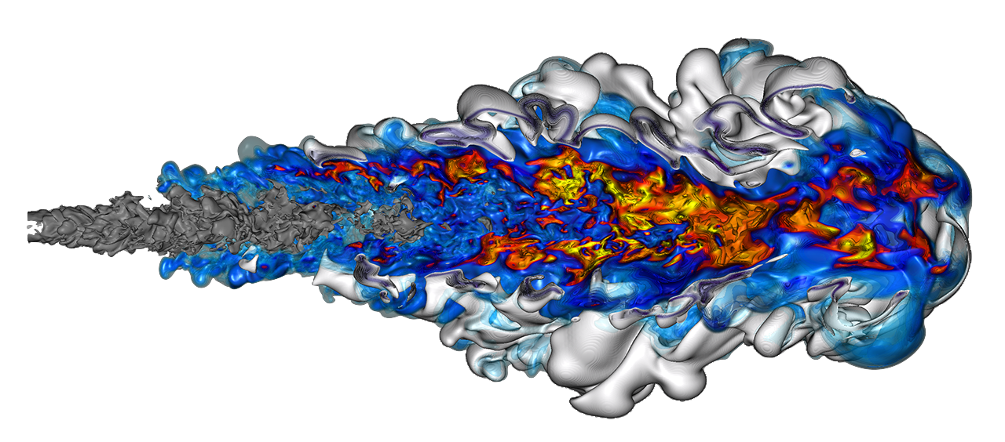


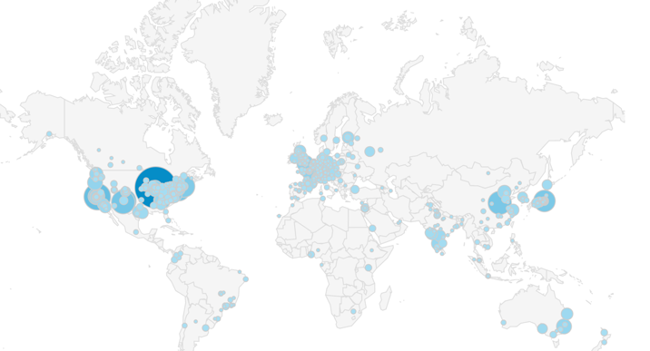



Large-scale collaboration enables us to support many downstream consumers
Facilities
Spack develop branch
Bleeding edge: 400-600 changes/month
Latest features and package versions
Applications
Consume software from any of these channels, via Spack
Use bleeding edge or stable
Spack release branches
Stable spack
Stable package versions
Bugfixes backported
E4S release branches
Facility testing
Curated public build caches (manually created)
External Contributors
on GitHub
Software Integration at HPC Facilities
Local builds and testing
Local configuration
Local filesystem installation
Local module scheme
We want to move last-mile effort upstream and eventually deploy from binaries

Slide 40

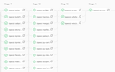


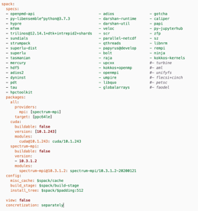
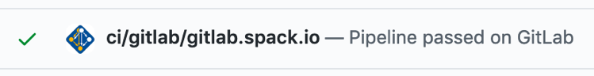
Spack relies on cloud CI to ensure that builds continue working
Spack Contributions
on GitHub (over 1,000 contributors)
gitlab.spack.io
x86_64 and aarch64 pipelines in AWS
ppc64le, GPU pipelines at UO (Frank machine)
spack ci
HPE/Cray pipelines
spack.yaml configurations
(E4S, SDKs, AWS, others)
GitLab CI builds (changed) packages
On every pull request
On every release branch

Slide 41
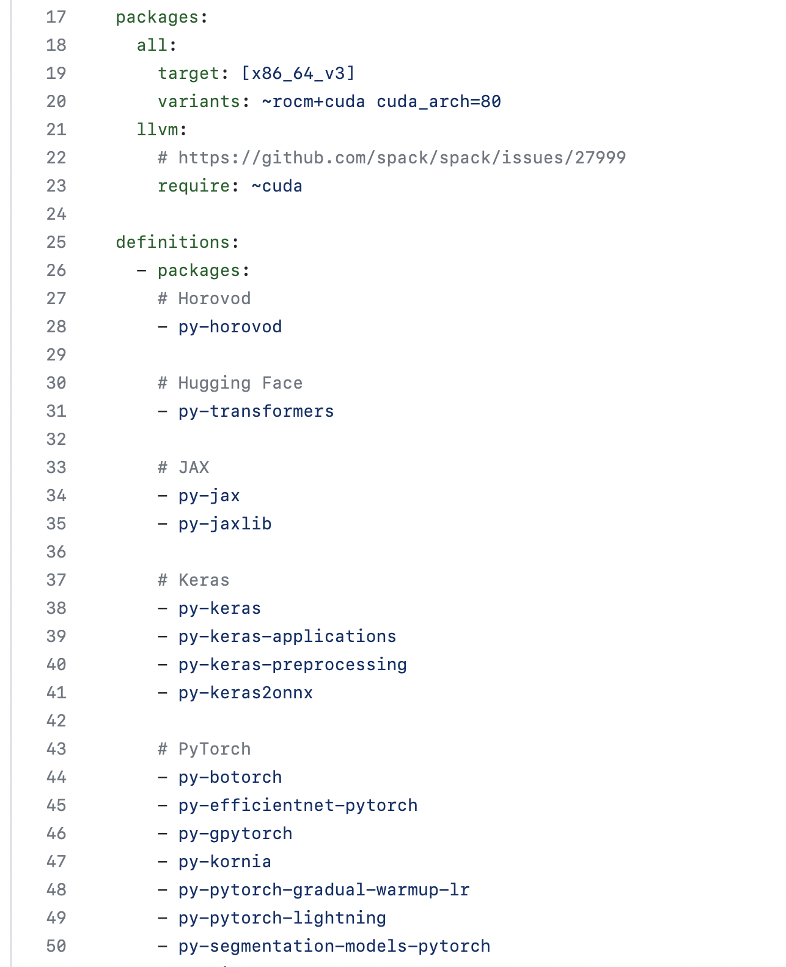
We have greatly simplified the process of creating a stack
Config parameters
Lists of packages aimed at communities
E4S HPC distribution
Power, macOS, OneAPI versions
Various ML stacks
CPU
CUDA
ROCm
LLNL-specific stacks
AWS user stacks
Easy to build same stack many different ways using versatile recipes
No more boilerplate!
List of packages

Slide 42






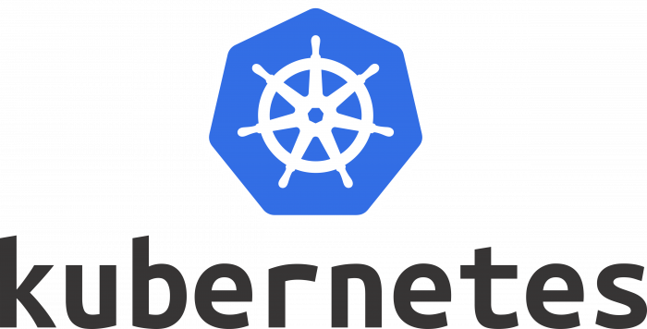


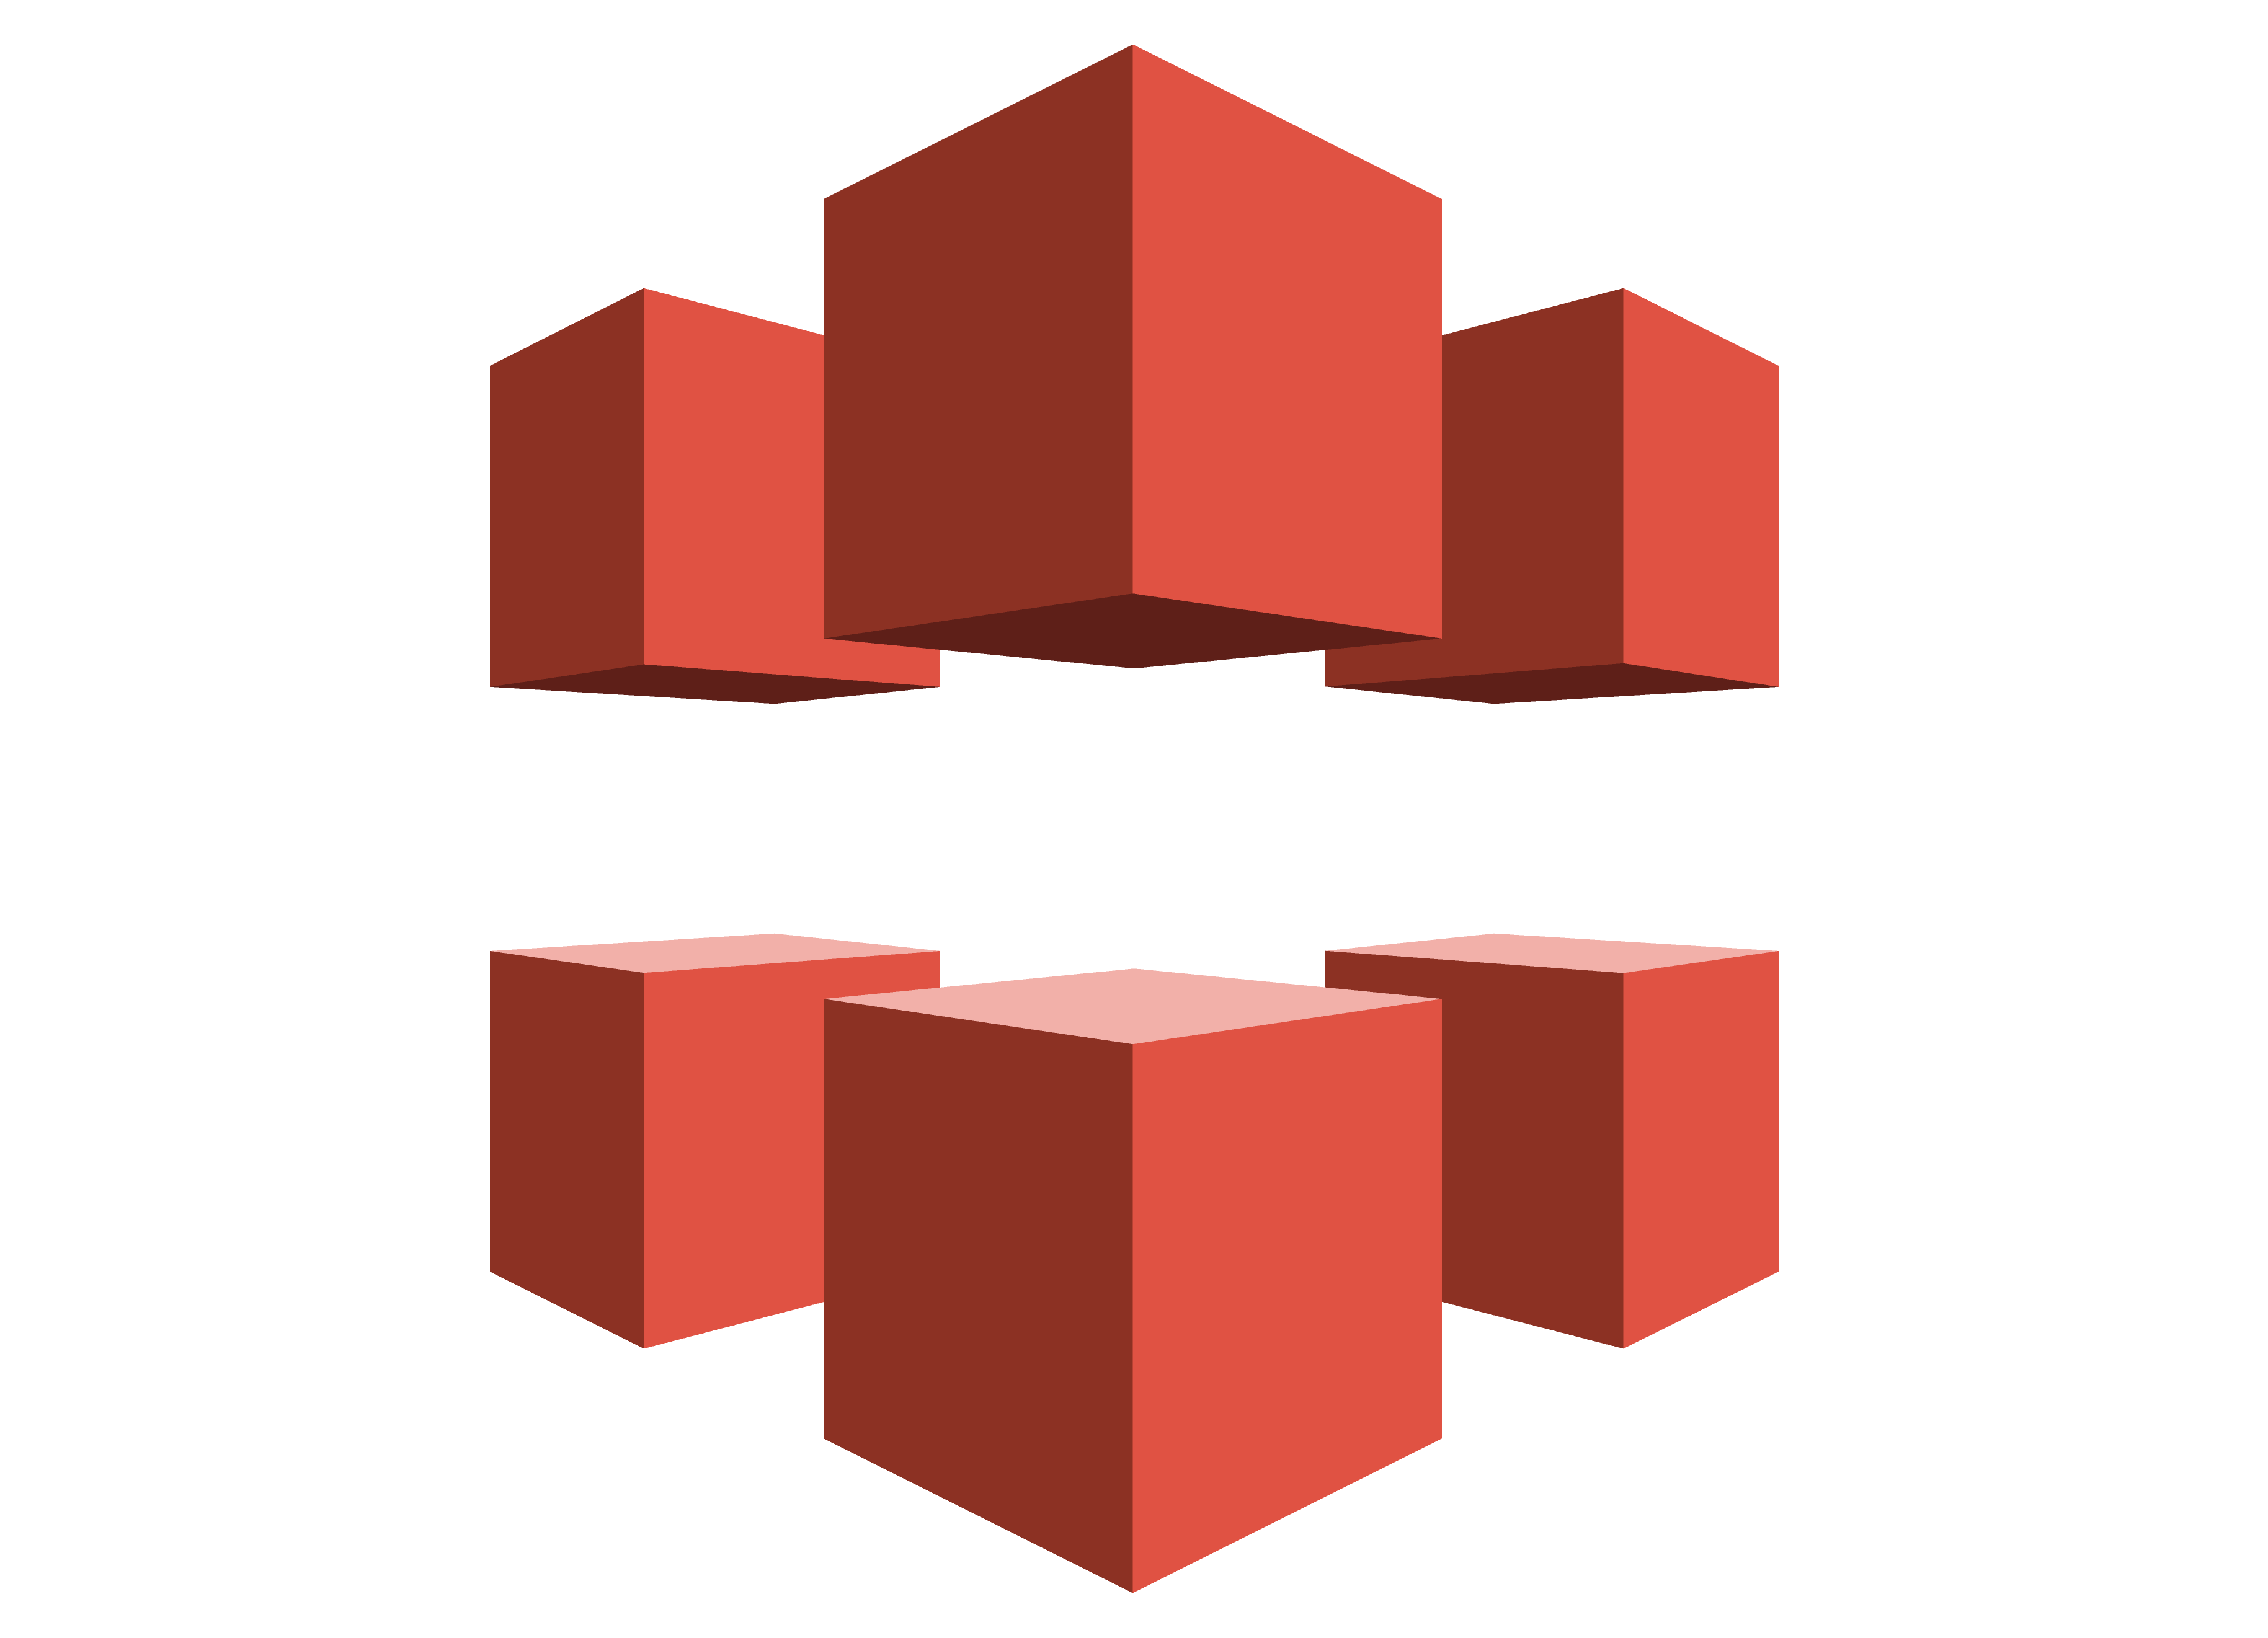
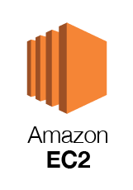


Spack CI Architecture
NVIDIA
etc.
MI200
etc.
a64fx
etc.
Spack on GitHub
Monitoring
HA GitLab
Power9
Runner Pools
Runner Pools
Runner Pools
Runner Pools
Bare metal runners on “Frank” cluster
spackbot
(EKS)
Real HPC test environments?
S3
CloudFront

Slide 43
We ensure rapid turnaround and protect against malicious binaries by bifurcating our pipeline
Untrusted S3 buckets
Public, signed binaries in CDN
Internal per-PR build caches
https://binaries.spack.io
github/pr-28468
github/pr-28469
develop
releases/v0.18
…
…
Contributors submit package changes
Maintainers review PRs
Rebuild and Sign
Iterate on builds in PR
Caches prevent unnecessary rebuilds
Verify PR build succeeded
Review package code
Protected signing runners
Ephemeral keys
Merge to develop
Published binaries built ONLY from approved code
Moves bulk of binary maintenance upstream, onto PRs
Production binaries never reuse binaries from untrusted environment

Slide 44
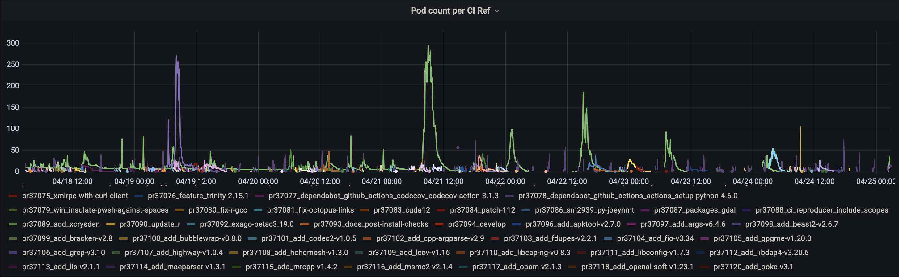
Our CI system enables us to build entire software stacks within a single pull request
Users can write a simple file and fire up 300+ builders to build thousands of packages
We’re currently handling 50,000 – 100,000 package builds per week

Slide 45



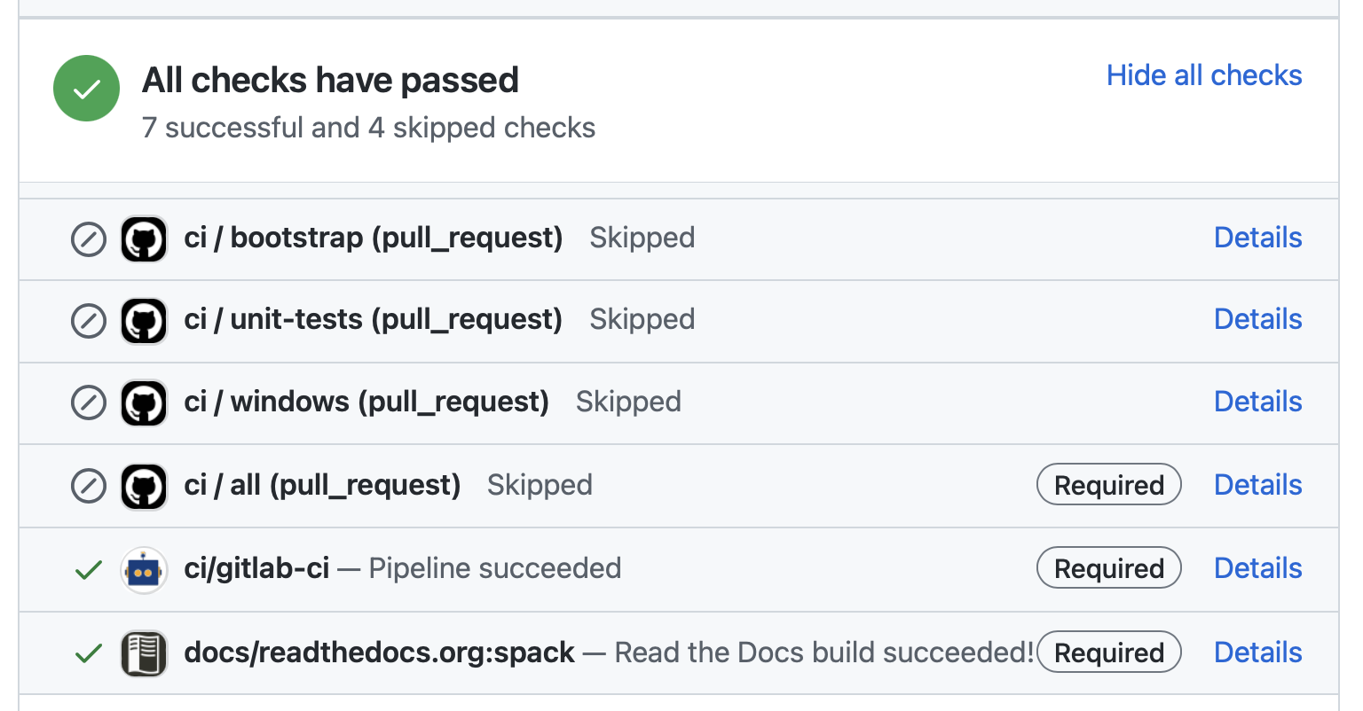
We announced our public binary cache at ISC22. We’re maintaining ~4,600 builds in CI!
✅ Easy (mostly) for contributors!
# latest v0.18.x release binaries
spack mirror add v018 https://binaries.spack.io/releases/v0.18
# rolling release: bleeding edge binaries
spack mirror add develop https://binaries.spack.io/develop
✅ Easy for users!
⚠️ Still need HPC CI, but working on it
So, what else could go wrong?

Slide 46
We are working with code teams to develop standard workflows for layered build farms
We are working with the MARBL team to move their development environment to Spack
We have established a build and deployment working group among WSC codes
We aim to put together an L2 milestone for next year to:
Make a common build farm for WSC codes
Layer with Spack’s public build farm
Gradually bring teams together around standard build configurations and workflows
llnl.wci.mapp
marbl
blast
miranda
MARBL Packages
Common WSC packages
llnl.wci
leos
builtin
Mainline Spack packages
boost
raja
axom

Slide 47




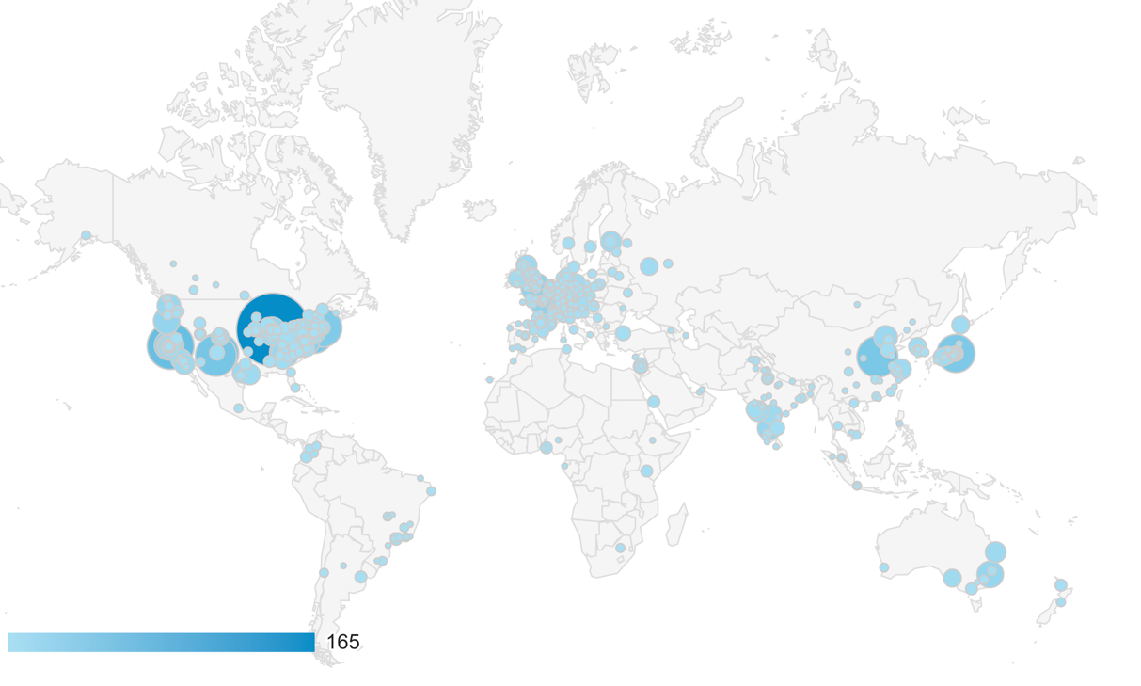

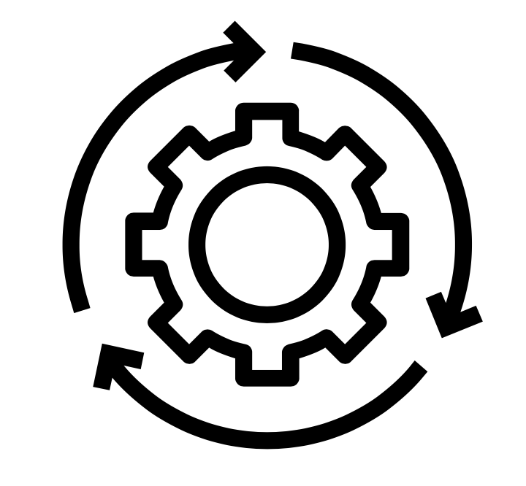



A Notional Secure Pipeline
Binary Packages
Open Source Contributions
Tarballs, other sources
Git commits
Verify
Scan
Build
Sign
Scan
Deploy
Container Images
Spack has 6,500 packages, with many updates per day.
Container Build
Sign
Verify
We need a standard set of guidelines that we accept for supply chain integrity
Labs are trending towards GitLab, Spack for HPC
Standard container formats can help with scanning
Standard SBOM format could help sites cross-validate codes
“Thorn Thymus” LDRD Strategic Initiative is working on new ways to recognize malware
Could integrate this into our pipeline when it’s ready

Slide 48
Spack retains more software provenance than most SBOMs
{
"spec": {
"_meta": {
"version": 3
},
"nodes": [
{
"name": "zlib",
"version": "1.2.12",
"arch": {
"platform": "darwin",
"platform_os": "bigsur",
"target": {
"name": "skylake"
}
},
"compiler": {
"name": "apple-clang",
"version": "13.0.0"
},
"namespace": "builtin",
"parameters": {
"optimize": true,
"pic": true,
"shared": true,
"cflags": [],
"cppflags": [],
"cxxflags": [],
"fflags": [],
"ldflags": [],
"ldlibs": []
},
"hashes": {
"archive": "91844808532e5ce316b3c010929493c0244f3d37593afd6de04f71821d5136d9",
"patches": [
"0d38234384870bfd34dfcb738a9083952656f0c766a0f5990b1893076b084b76"
],
"package_hash": "6kkliqdv67ucuvfpfdwaacy5bz6s6en4"
},
"hash": "zbntgjjnd2wgvvkfi55y45ms3p7wg5ns"
}
]
}
}
Schema version
Package name
Spec for zlib is at left
Contains much of the metadata SBOM asks for
Plus performance/build info of interest to HPC folks
Patch, archive, and package recipe hashes allow you to verify the build
These are currently not exposed
We hash them and include the result
Can easily replace the hash with specific archive/patch hashes
SBOM generation from this data is in progress
All Spack installs will have SBOMs to leverage industry tooling
Version
Compiler, target architecture
Origin package repo
Variants, build options, flags
Hashes of archive, patches, build recipe
Hash of entire spec

Slide 49
Future directions we would like to pursue
Build pipeline hardening / scanning
Add scanning and assurance stages to our build pipeline
Work with other projects to add assurance technologies
OpenSSF project has automated checks that can be integrated with CI pipelines
LLNL Thorn Thymus project has scanning
Package curation
Identify and label projects within Spack that meet security standards
Curate a vetted sub-distribution of software
Work with projects like E4S
Certified system images (for embedded devices, HPC, cloud, containers, etc.)
Configure and build a custom OS image with only selected components/options
Spack currently supports software above libc, but not libc
Contributors from the embedded community are working with us on this low-level support
May be used to replace tools like Yocto, OpenWRT, Gentoo

Slide 50
Roadmap: Separate concretization of build dependencies
We want to:
Build build dependencies with the "easy" compilers
Build rest of DAG (the link/run dependencies) with the fancy compiler
2 approaches to modify concretization:
Separate solves
Solve run and link dependencies first
Solve for build dependencies separately
May restrict possible solutions (build ←→ run env constraints)
Separate models
Allow a bigger space of packages in the solve
Solve all runtime environments together
May explode (even more) combinatorially
spack install pkg1 %intel
1
1
B
B
L
B
5
2
5
2
B
L
B
L
L
B
L
B
6
6
7
4
7
3
4
3
R
R
R
“Easy” compiler
8
8
Fancy compiler
B: build L: link R: run

Slide 51
Roadmap: Compilers as dependencies
Need separate concretization of build dependencies to make this work
Model compiler as build dep (not unified)
Runtimes as link deps (unified)
Ensure compatibility between runtimes when using multiple compilers together
We need deeper modeling of compilers to handle compiler interoperability
libstdc++, libc++ compatibility
Compilers that depend on compilers
Linking executables with multiple compilers
Packages that depend on languages
Depend on cxx@2011, cxx@2017, fortran@1995, etc
Depend on openmp@4.5, other compiler features
Model languages, openmp, cuda, etc. as virtuals
Compiler-imposed dependency
1
2
L
B
B
intel@16
intel@17
L
L
R
gcc@4.9.3
R
gcc@xxx
libstdc++
Compilers and runtime libs fully modeled as dependencies

Slide 52
When would we go to “Version 1.0”?
Big things we’ve wanted for 1.0 are:
New concretizer
production CI
production public build cache
Compilers as dependencies
Stable package API
Enables separate package repository
We are still working on the last 3 here, but getting much closer!
Done!

Slide 53


Join the Spack community!
There are lots of ways to get involved!
Contribute packages, documentation, or features at github.com/spack/spack
Contribute your configurations to github.com/spack/spack-configs
Talk to us!
You’re already on our Slack channel (spackpm.herokuapp.com)
Join our Google Group (see GitHub repo for info)
Submit GitHub issues and pull requests!
Star us on GitHub!
Follow us on Twitter!
github.com/spack/spack
@spackpm
We hope to make distributing & using HPC software easy!

Slide 54
Disclaimer
This document was prepared as an account of work sponsored by an agency of the United States government. Neither the United States government nor Lawrence Livermore National Security, LLC, nor any of their employees makes any warranty, expressed or implied, or assumes any legal liability or responsibility for the accuracy, completeness, or usefulness of any information, apparatus, product, or process disclosed, or represents that its use would not infringe privately owned rights. Reference herein to any specific commercial product, process, or service by trade name, trademark, manufacturer, or otherwise does not necessarily constitute or imply its endorsement, recommendation, or favoring by the United States government or Lawrence Livermore National Security, LLC. The views and opinions of authors expressed herein do not necessarily state or reflect those of the United States government or Lawrence Livermore National Security, LLC, and shall not be used for advertising or product endorsement purposes.

